Slide 1
OOD: coupling and cohesion, overloading, overriding Interface, Aggregation, Composition, Modularity.
By Mykhailo Torskyi

Slide 2
СOUPLING
JavaScript modules are the most prevalently used design patterns for keeping particular pieces of code independent of other components. This provides loose coupling to support a well-structured code.

Slide 3
Degree is the number of connections between the module and others. You want to keep this as lower as possible
Ease - an obvious all the connections between the module and the others with coupling you want the connections to be easy to make without needing to understand the implementations of the other modules
Flexibility is how interchangeable at the other modules are for this module with coupling, you want to the other modules easily replaceable for something better in the future

Slide 4
COHESION
Represents the clarity of the responsibilities of a module
Сhange the module so that it is only responsible for one thing at a time
Cohesion refers to what the class (or module) can do. Low cohesion would mean that the class does a great variety of actions - it is broad, unfocused on what it should do. High cohesion means that the class is focused on what it should be doing, i.e. only methods relating to the intention of the class.

Slide 5
Cohesion and Coupling
Cohesion is a measure of: functional strength of a module.
A cohesive module performs a single task or function.
Coupling between two modules: a measure of the degree of interdependence or interaction between the two modules.
Cohesion and Coupling module having high cohesion and low coupling: functionally independent of other modules: A functionally independent module has minimal interaction with other modules.

Slide 6
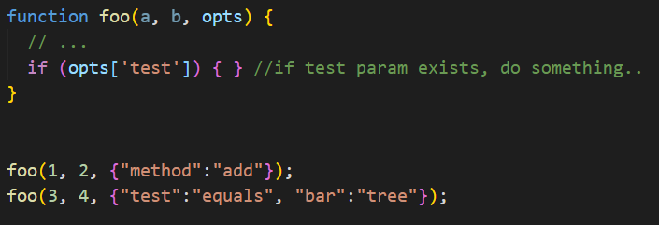
OVERLOADING
Overloading allows different methods to have the same name, but different signatures where the signature can differ by the number of input parameters or type of input parameters or both. Overloading is related to compile-time (or static) polymorphism.

Slide 7
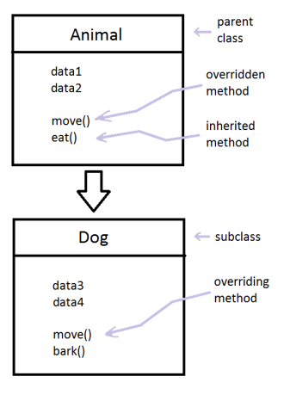
OVERRIDING
Allows a subclass or child class to provide a specific implementation of a method that is already provided by one of its superclasses or parent classes. The implementation in the subclass overrides (replaces) the implementation in the superclass by providing a method that has the same name, same parameters or signature, and same return type as the method in the parent class.

Slide 8
AGGREGATION
Aggregation is a term which is used to refer one way relationship between two objects
Represents HAS-A relationship, which means when a class contains a reference to another class known to have aggregation
Class A has-a relationship with class B, if class A has a reference to an instance of class B.

Slide 9
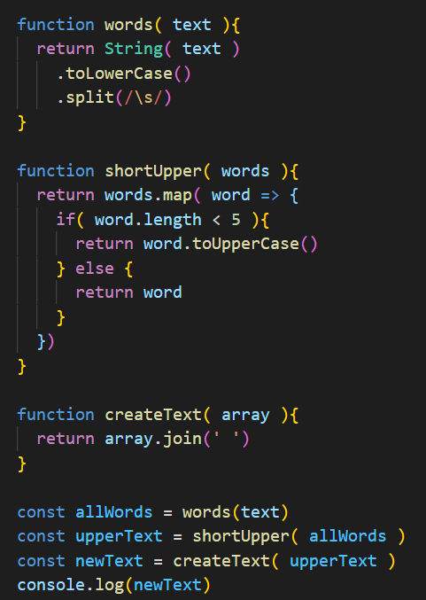
COMPOSITION
The idea is to create something from other parts. It's easier to build something complex if it consists of many small parts that we understand. The other big reason is reusability. Bigger and more complex things can sometimes share parts they consist of, with other big and complex things.

Slide 10
MODULARITY
Modularity helps the process of organizing the entire code base. So if modular approach is not applied then the structure will grow and become out of control. The modular approach in javascript programming helps to develop more structured code and make it easily maintainable.
In modular programming approach, we follow two things when make the structure of the application:
Separate different functionalities into smaller part which forms the module
Make the relation between the modules

Slide 11


